Slide 1
Customer Order Maintenance
Assignment #6
Database Fundamentals

Slide 2
Overview:
Assignment 6 involves adding and editing customer orders
Learning objective is handling data from 1:Many relationships on a form
Uses data in 4 tables
  customer
  orderHeader
  orderDetail
  part
One customer can have
many oders
One order can have
many parts

Slide 3
Overview: browseOrder mode
Browsing Orders
(top part of form enabled, lower part disabled)
User starts by selecting a customer from the list box in the upper right
When user clicks on a customer
  the selected customer’s data is displayed to the right (these fields are not editable so they are locked text boxes or labels)
  The open orders list box is requeried to display only the orders for the selected customer

Slide 4
Overview: modifyOrder mode
Modifying Orders
User may
  Add a new order for the selected customer
    Enter parts ordered in the subform
  Edit an existing order
    User must select an open order from the list box
    When the user selects an order by clicking on it the details of the selected order will be displayed in the subform
(top of form disabled and bottom part enabled)

Slide 5
Overview: modifyOrder mode
Modify Orders
  User may add/edit/delete items (parts) on order

Slide 6
Overview: modifyPart mode
Modify Items
  Add/Edit click changes the user to modify items mode
    Subform disappears and text boxes behind the subform are visible
    Text boxes are empty for ‘add’ and filled with data from the currently selected parts line in the subform

Slide 7
Overview: modifyPart mode
User selects a part from the combo box populated from all parts in the part table (combo box includes partID, Description and list price)
When a part is selected the list price box is populated with price associated with the selected part
User must supply quantity on order
User may override price by entering value in text box
User signals they are done modifying items by clicking Save or Cancel
Pressing Save writes the data from the text boxes to the orderDetail table and returning to modifyOrder mode
Form reverts to modifyOrder mode

Slide 8
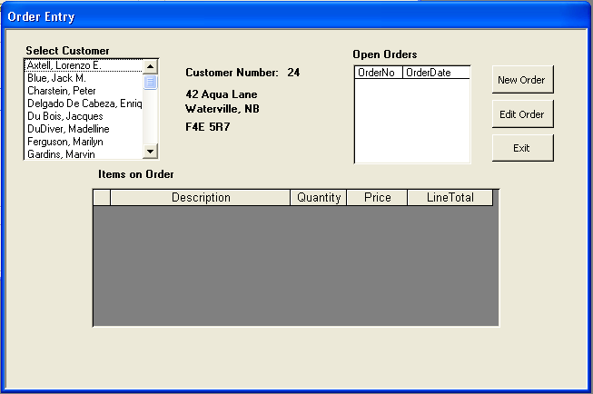
Design – Step 1 (Basic Form)
Form and text boxes UnBound
Caption
No Close Button
No Min/Max Buttons
Locking routine
“browseOrder” mode
Coding Tips...
The design is all yours!

Slide 9
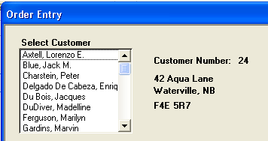
Design – Step 2 (Customer ListBox)
Include fields which are tied to Customer information in Alpha Order.
Text/labels updated when customer selected
Coding Tips...
After Update Event or On Click event
.Find record in customer record set based on value of listbox

Slide 10
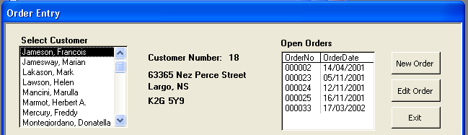
Design – Step 3 (Order Header)
Add Order Header listbox and tie it to a query that selects only the current Customer and only “Open” orders
An order is “Open” if it has not been shipped
Note the Custno is included as a link back to the customer record
customer number
field is part
of listbox record
source but hidden
Coding tips...
Order list box record source has 4 fields, bound to orderNumber
Includes but doesn’t show customer number and printed status
Criteria in query for customerNumber = the customer number textbox on left
Requery order list box when customer selected so it refreshes to show current customer’s order only

Slide 11
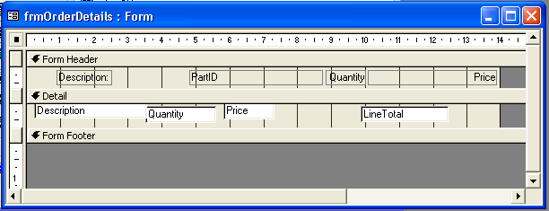
Design – Step 4a (SubForm)
Create a new form based on a query
Use DataSheet View (linear – 1 record per row)
Include key fields in query (lineNumber and orderNumber)
These fields not visible but must be there to
a) link the subform to the mainform so display only orderDetails for selected orderNumber in listbox
b) lineNumber to uniquely identify a line (orderDetail record) to edit/delete

Slide 12
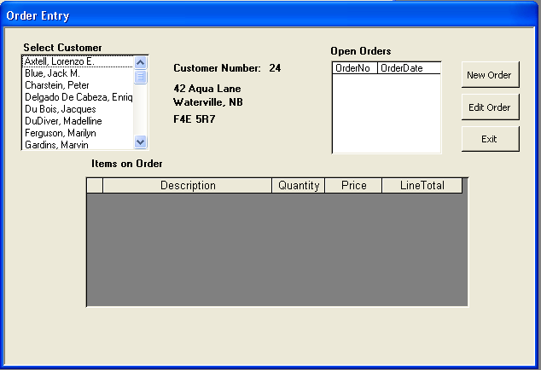
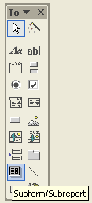
Design – Step 4b (SubForm)
Add the new form to the main form as a “Sub Form”
Set Sub Form Properties:
  Source Object, Link Child Fields, Link Master Fields

Slide 13
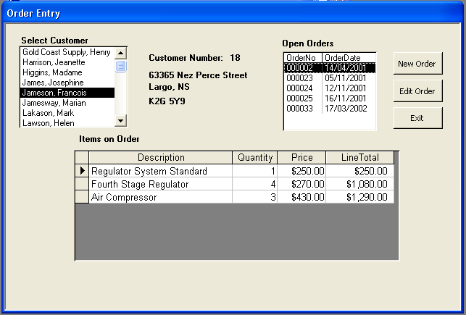
Design – Step 4c (SubForm)
Click on Order Number to show Order Details for that order
Coding tips...
Order ListBox click Event
“subform”.requery

Slide 14
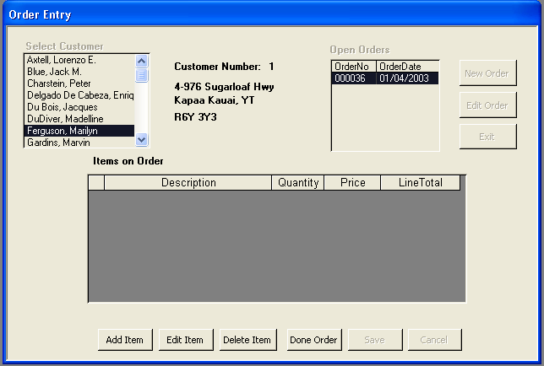
Design – Step 5 (Add New Order)
“Modify Order” mode
Buttons visible for maintaining order details
Must have selected
a customer
Add new Order Header record
“modifyOrder” mode
Buttons visible for maintaining order details
No parts
(orderDetail) added… yet
Coding Tips...
.addNew method on the orderHeader recordset
Set the customer number to the currently selected customer, the date of the order to the current date and printed to false
Update the orderHeader recordset to write the new record to the set
Requery the order list box so it shows up

Slide 15
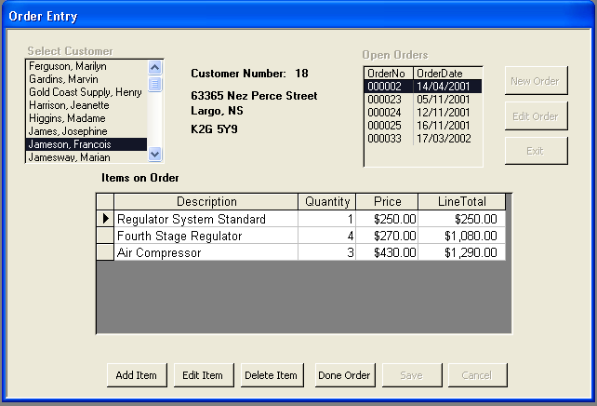
Design – Step 6 (Modify Existing Order)
Must have selected a customer and an order number
“modifyOrder” mode
Buttons visible for maintaining order details
orderDetail contains parts on order data

Slide 16
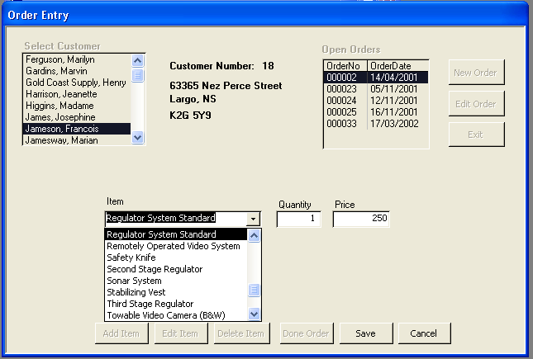
Design – Step 7 (Under SubForm)
Create a 3 column combo box from query of parts in Alpha order
(partID, description, listprice)
Add text boxes for quantity and price

Slide 17
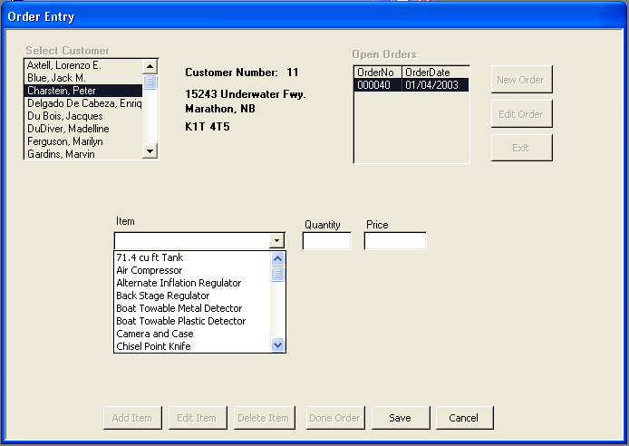
Design – Step 8a (Add Part)
“modifyPart” mode
Set all three controls to empty

Slide 18
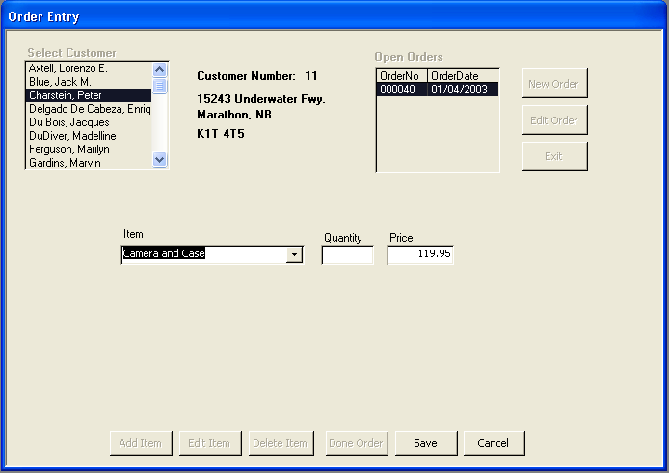
Design – Step 8b (Add Part)
List Price from combo box is displayed in “Price”
Price can be entered if different (eg. sale price)
Quantity must be entered
Coding tips...
Combo Box Change Event
txtPrice = cboPart.Column(n)

Slide 19
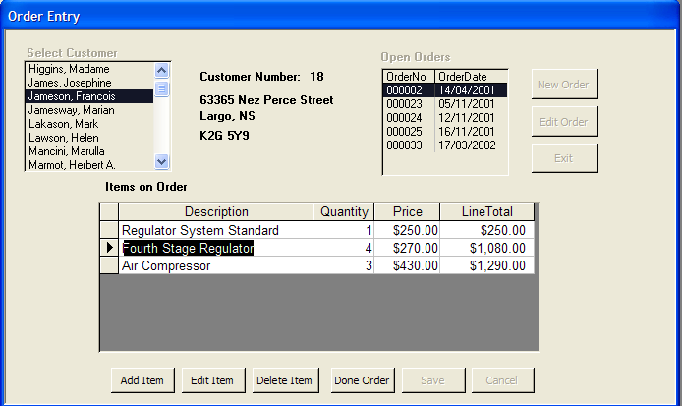
Design – Step 9a (Edit Part)
A line on subform must be selected
“modifyPart” mode
Coding tips...
To ensure that a line on the subform was selected check that subforms .Form!LineNo isn’t Null

Slide 20
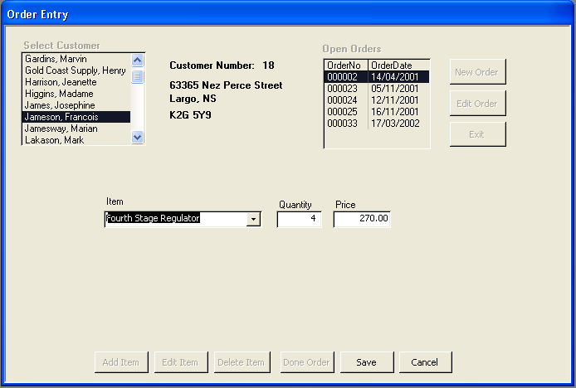
Design – Step 9b (Edit Part)
Find the Order Detail based on the line number
Fill in the Combo and text boxes with data from the line chosen
Coding tips...
to find the selected orderDetail record use the .Find method on the orderDetail recordset to locate the record with LineNo = the currently selected subform lineNumber

Slide 21
Design – Step 10 (Delete Part)
Must select a line on the subform to delete
Confirm message to delete
Find the Order Detail based on the line number
Coding tips...
.Find method on the orderDetail recordset based on LineNo in the subform
.Delete
.Requery

Slide 22
Design – Step 11 (Save Part)
Check that Valid data has been entered
Adding vs Editing?
Set OrderDetail fields = data in combo and text boxes
Coding tips...
If Saving an Add Item – .addnew method on the orderDetail recordset
If Saving and Edit Item – position to the orderDetail record editing using
.Find method and subform’s line number
Set the fields in the record to the text/combo box values
.Update
.Requery

